Slide 1
How to Describe a Graph in Academic Writing?

Slide 2
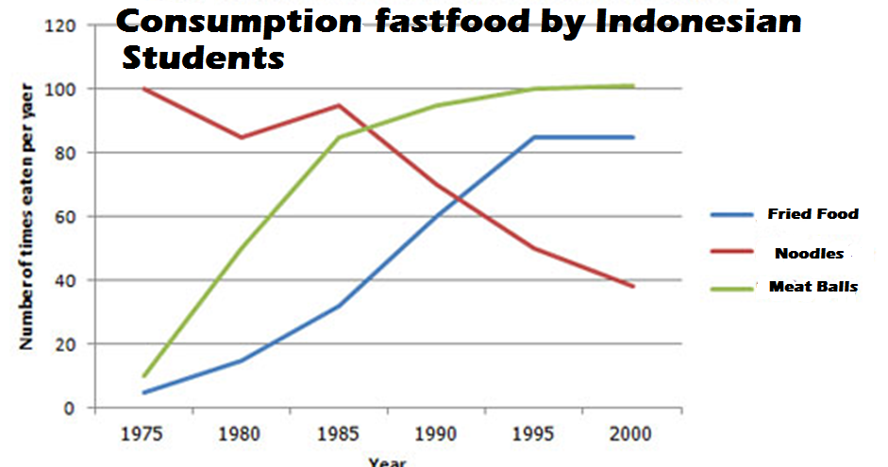
You should spend about 20 minutes on this task.
The line graph below shows changes in the amount and type of fast food consumed by Indonesian students from 1975 to 2000.
Summarize the information by selecting and reporting the main features and make comparisons where relevant.
Write at least 150 words.

Slide 3
There are three basic things you need to structure an Academic writing
Introduce the graph
Give an overview
Give the detail

Slide 4
1) Introduce the Graph
You need to begin with one or two sentences that state what the IELTS writing task 1 shows. To do this, paraphrase the title of the graph, making sure you put in a time frame if there is one.
Example:
The line graph compares the fast food consumption of students in Indonesia between 1975 and 2000, a period of 25 years

Slide 5
2) Give an Overview
You also need to state what the main trend or trends in the graph are. Don’t give detail such as data here – you are just looking for something that describes what is happening overall.
One thing that stands out in this graph is that one type of fast food fell over the period, whilst the other two increased, so this would be a good overview.
Here is an example:
Overall, the consumption of noodles declined over the period, whereas the amount of fried food and meet balls that were eaten increased.

Slide 6
3) Give the Detail
ou can now give more specific detail in the body paragraphs.
When you give the detail in your body paragraphs in your writing, you must make reference to the data.
The key to organizing your body paragraphs for an academic writing is to group data together where there are patterns.
To do this you need to identify any similarities and differences.
Look at the graph – what things are similar and what things are different?
As we have already identified in the overview, the consumption of noodles declined over the period, whereas the amount of fried food and meet balls that were eaten increased.
So it is clear that fried food and meet balls were following a similar pattern, but noodles were different. On this basis, you can use these as your ‘groups’, and focus one paragraph on noodles and the other one on fried foods and meet balls

Slide 7
3) Give the Detail (cont…)
Here is an example:
In 1975, the most popular fast food with Indonesian students was noodles, being eaten 100 times a year. This was far higher than fried foods and meet balls, which were consumed approximately 5 times a year. However, apart from a brief rise again from 1980 to 1985, the consumption of noodles gradually declined over the 25 year timescale to finish at just under 40.
The next body then focuses on the other foods:
In sharp contrast to this, teenagers ate the other two fast foods at much higher levels. Fried food consumption increased gradually until it overtook the consumption of noodles in 1990. It then levelled off from 1995 to 2000. The biggest rise was seen in meat balls as the occasions they were eaten increased sharply throughout the 1970’s and 1980’s, exceeding that of noodles in 1985. It finished at the same level that noodles began, with consumption at 100 times a year.

Slide 8
Full Model Answer:
The line graph compares the fast food consumption of students in Indonesia between 1975 and 2000, a period of 25 years. Overall, the consumption of noodles declined over the period, whereas the amount of fried food and meet balls that were eaten increased.
In 1975, the most popular fast food with Indonesian students was noodles, being eaten 100 times a year. This was far higher than fried foods and meet balls, which were consumed approximately 5 times a year. However, apart from a brief rise again from 1980 to 1985, the consumption of noodles gradually declined over the 25 year timescale to finish at just under 40.
In sharp contrast to this, teenagers ate the other two fast foods at much higher levels. Fried food consumption increased gradually until it overtook the consumption of noodles in 1990. It then levelled off from 1995 to 2000. The biggest rise was seen in meat balls as the occasions they were eaten increased sharply throughout the 1970’s and 1980’s, exceeding that of noodles in 1985. It finished at the same level that noodles began, with consumption at 100 times a year.

